Slide 1
Insights on income dynamics from two decades of administrative data
GRID Project Update
Matt Elias
08/11/2024

Slide 2
Variable definitions

Slide 3
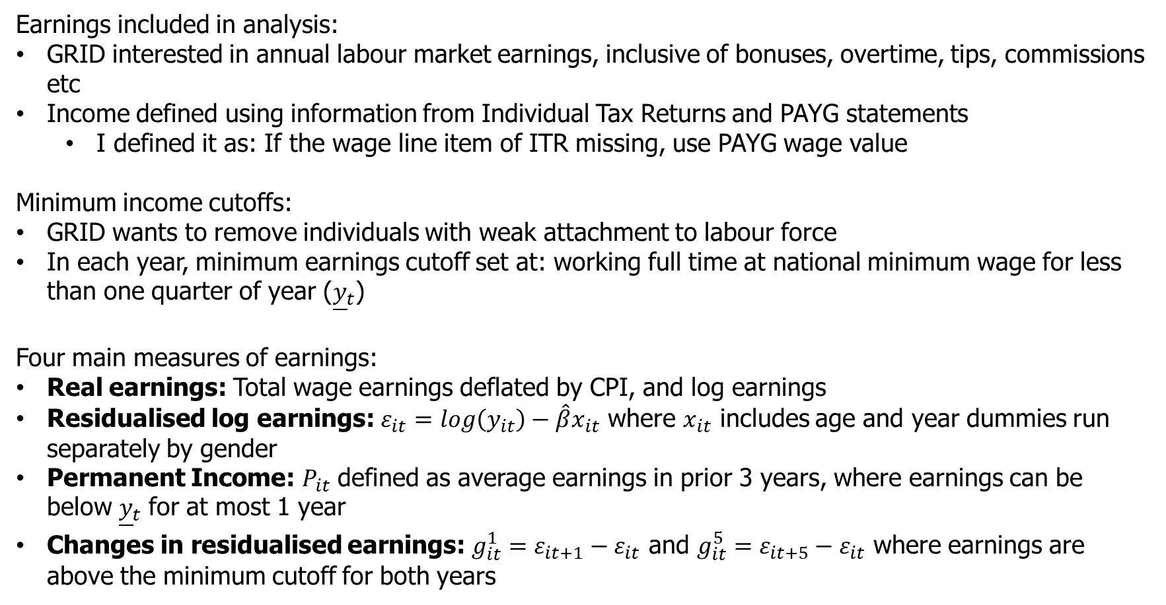
Variable construction
Earnings included in analysis:
GRID interested in annual labour market earnings, inclusive of bonuses, overtime, tips, commissions etc
Income defined using information from Individual Tax Returns and PAYG statements
I defined it as: If the wage line item of ITR missing, use PAYG wage value
Minimum income cutoffs:
GRID wants to remove individuals with weak attachment to labour force
In each year, minimum earnings cutoff set at: working full time at national minimum wage for less than one quarter of year (${\underline{y}}_{t}$)
Four main measures of earnings:
Real earnings: Total wage earnings deflated by CPI, and log earnings
Residualised log earnings: $ε_{it}=log\left(y_{it}\right)−\hat{β}x_{it}$ where $x_{it}$ includes age and year dummies run separately by gender
Permanent Income: $P_{it}$ defined as average earnings in prior 3 years, where earnings can be below ${\underline{y}}_{t}$ for at most 1 year
Changes in residualised earnings: $g_{it}^{1}=ε_{it+1}−ε_{it}$ and $g_{it}^{5}=ε_{it+5}−ε_{it}$ where earnings are above the minimum cutoff for both years

Slide 4
Australia specific coding issues
Bottom coding:
Occurs due to non-filing of tax returns below the tax-free threshold
Use PAYG data as primary source to address this is part
Top coding:
Values above an earnings level are censored by the ABS
Top coded value changes depending on variable and changes across different years
XXX [outline]

Slide 5
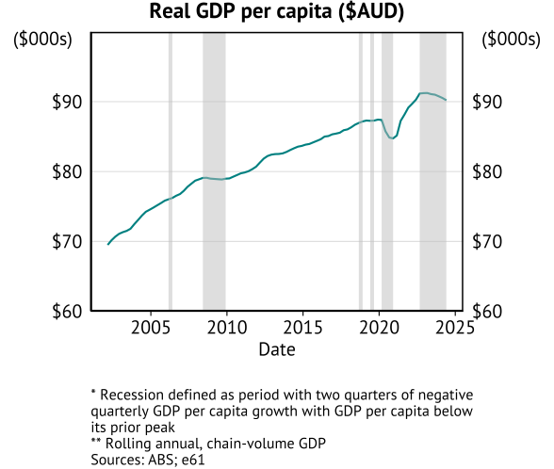
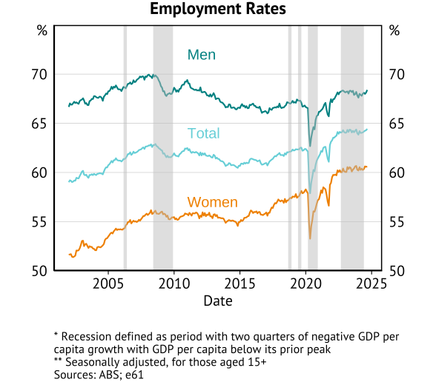
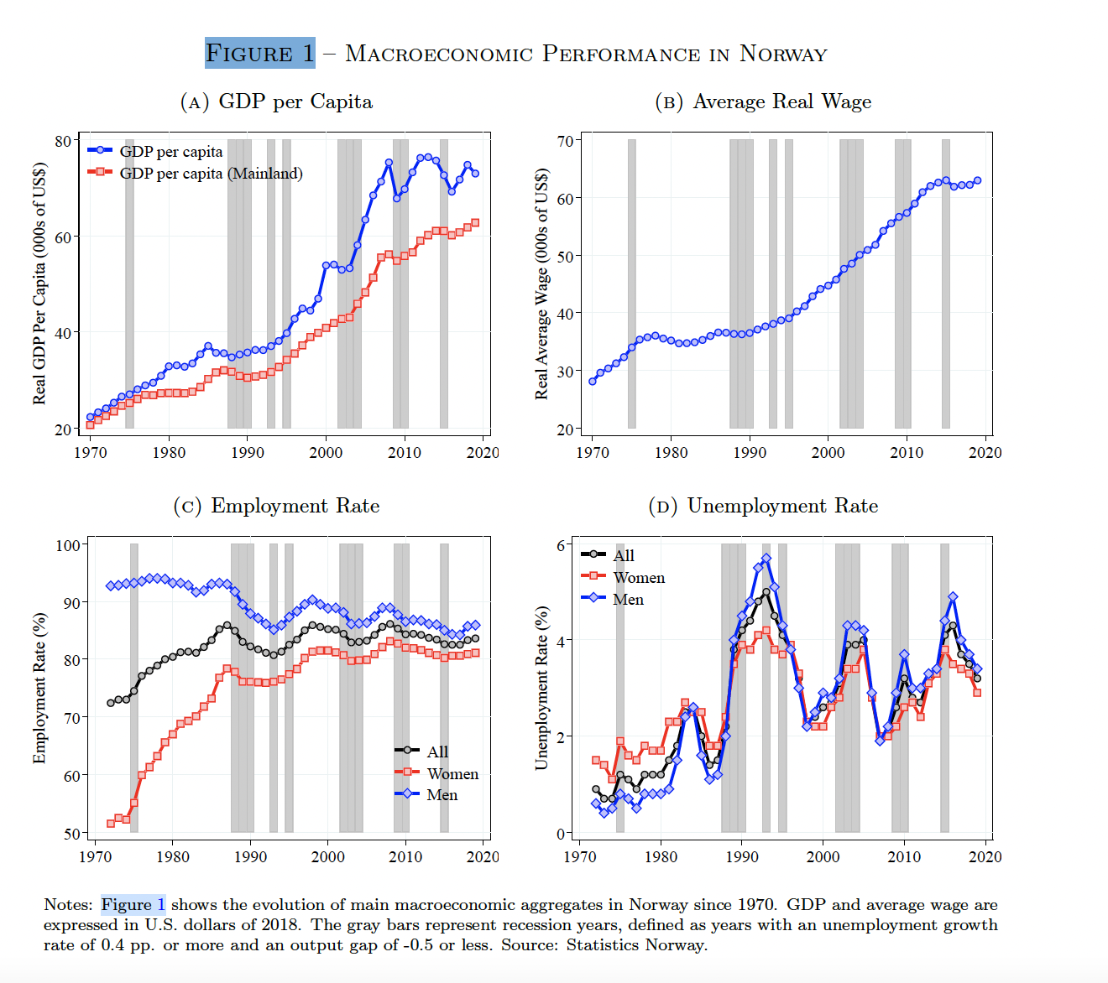
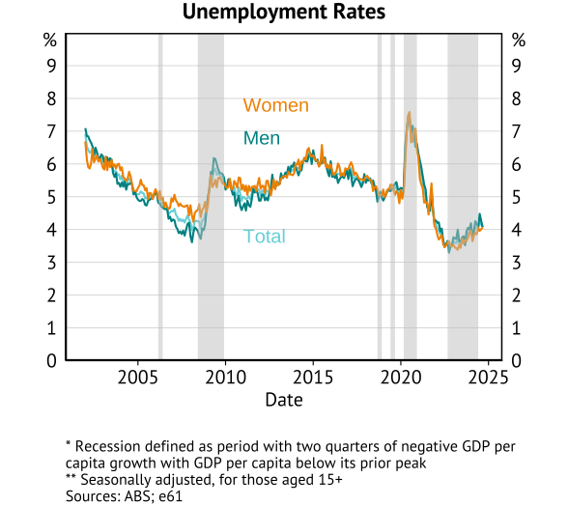
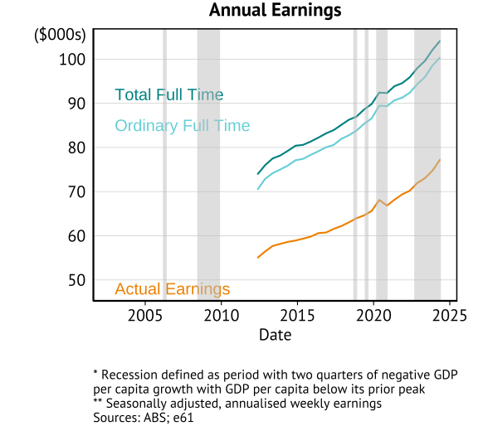
Macroeconomic performance
Graph on the Australian macro context:
timing of recessions over past 20 years
GDP growth
Unemployment rate

Slide 6
Inequality

Slide 7
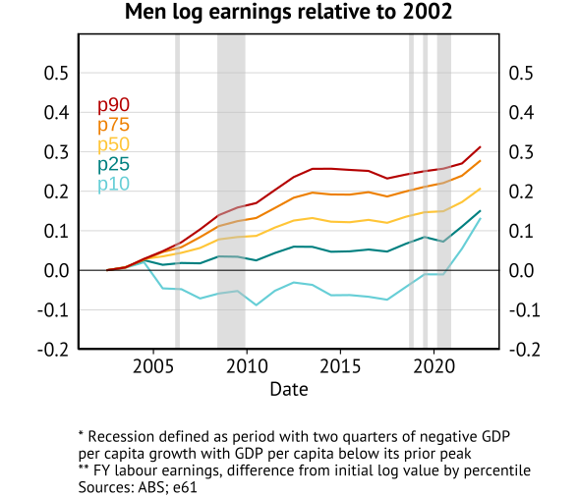
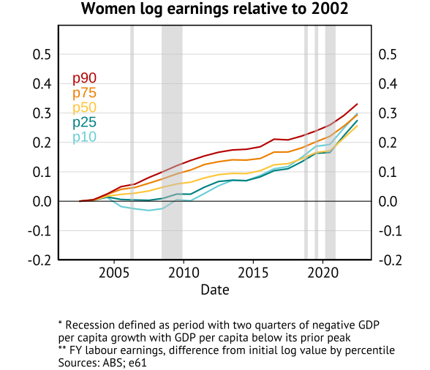
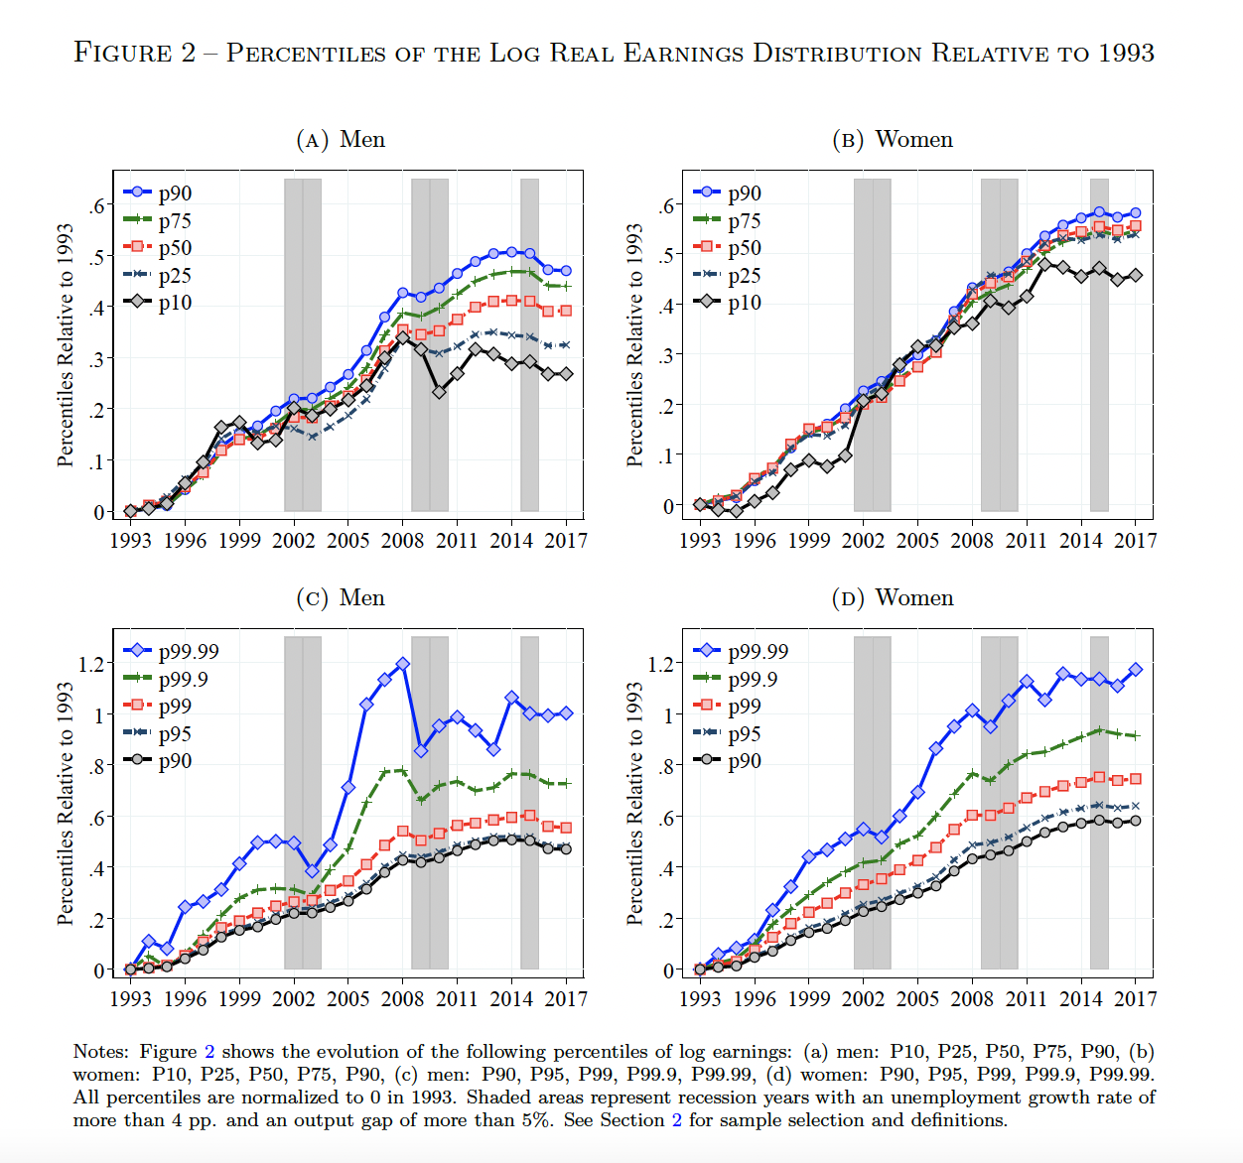
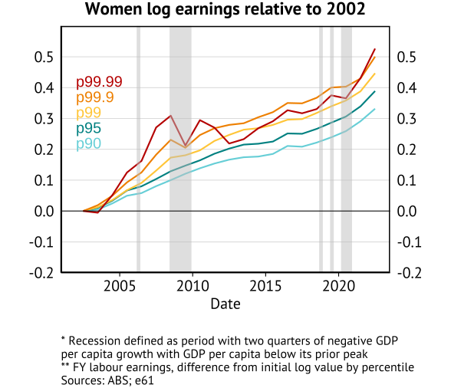
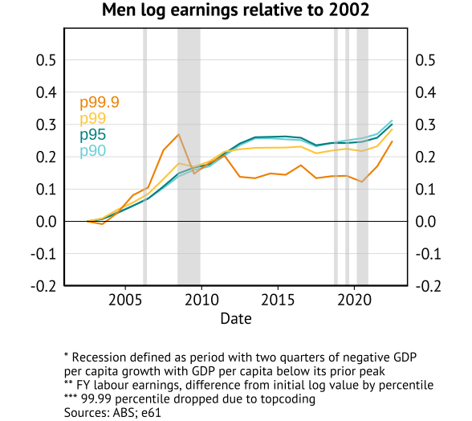
Inequality figures
Percentiles of the Log Real Earnings Distribution relative to 2002

Slide 8
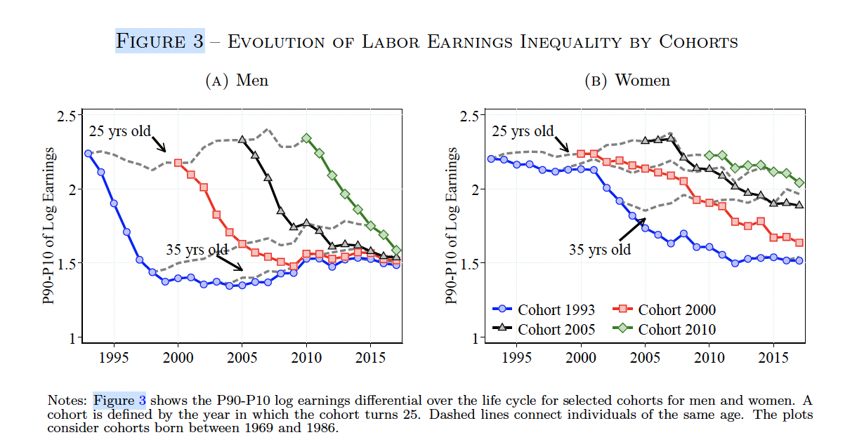
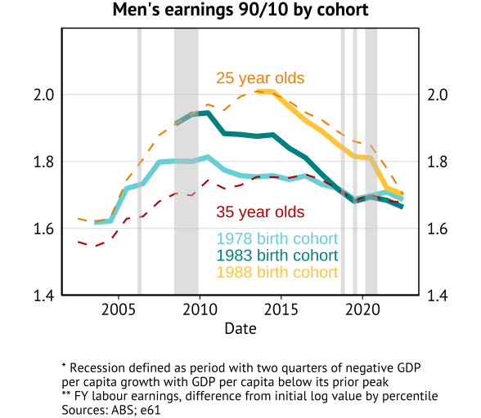
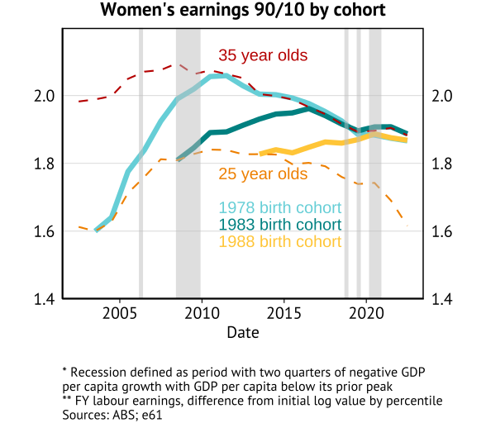
Inequality figures
Evolution of Labour Earnings Inequality by Cohort

Slide 9
Volatility

Slide 10
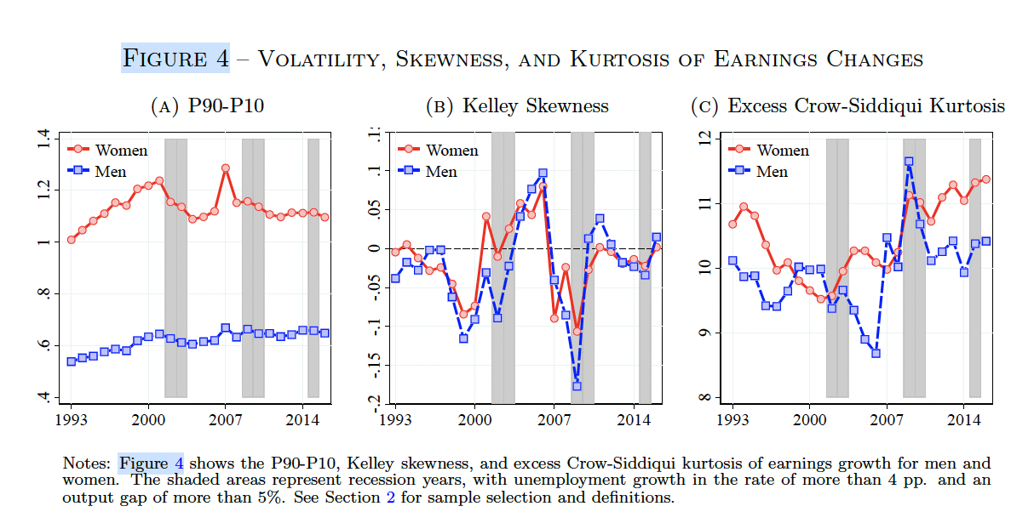
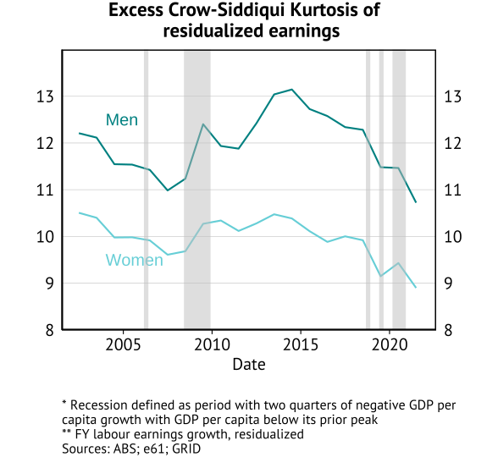
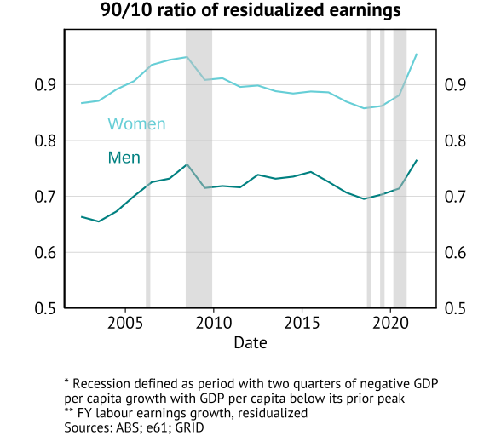
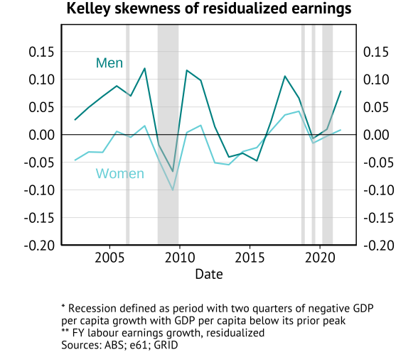
1yr growth of residualised earnings

Slide 11
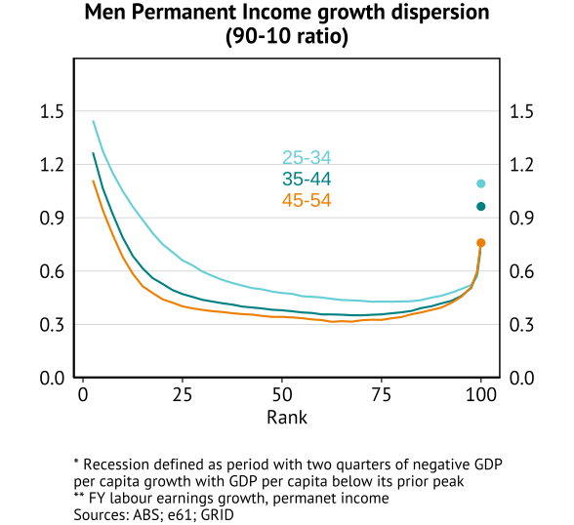
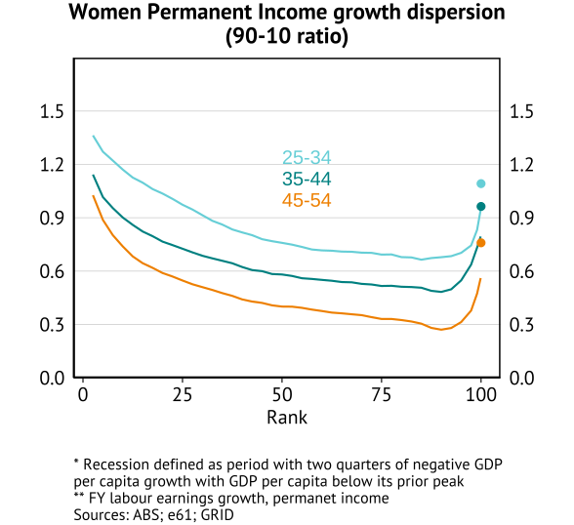
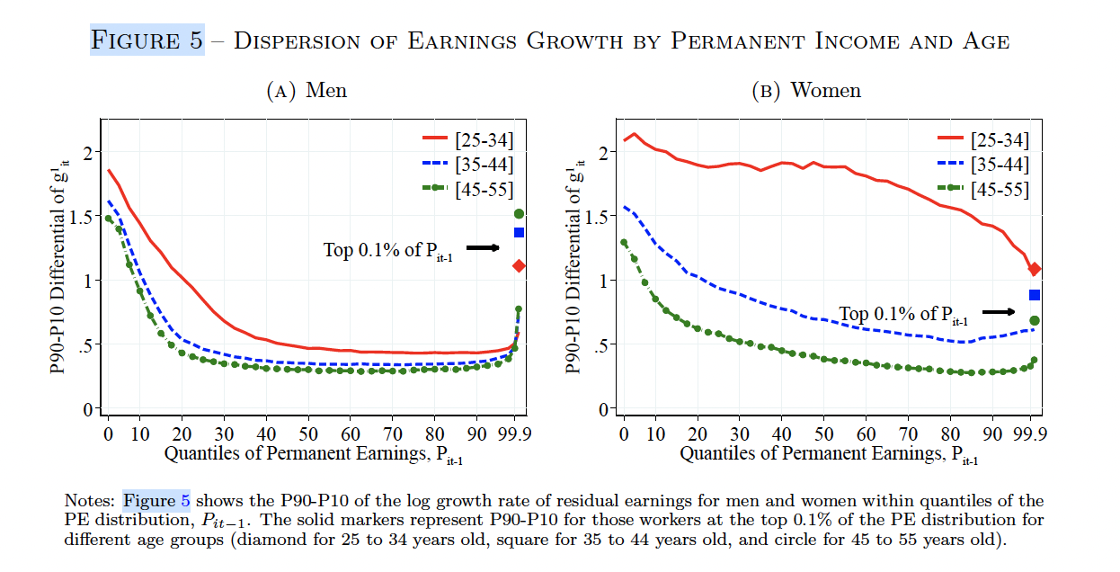
1yr growth of residualised earnings by permanent income

Slide 12
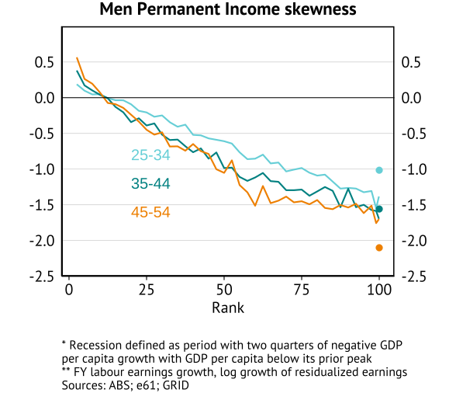
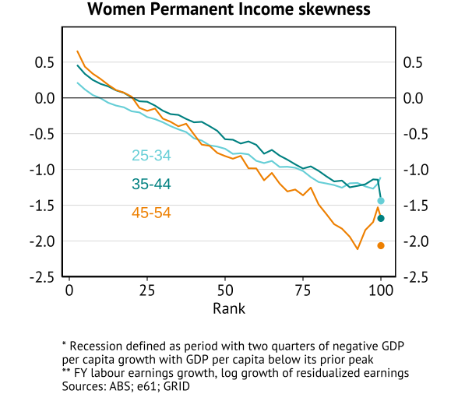
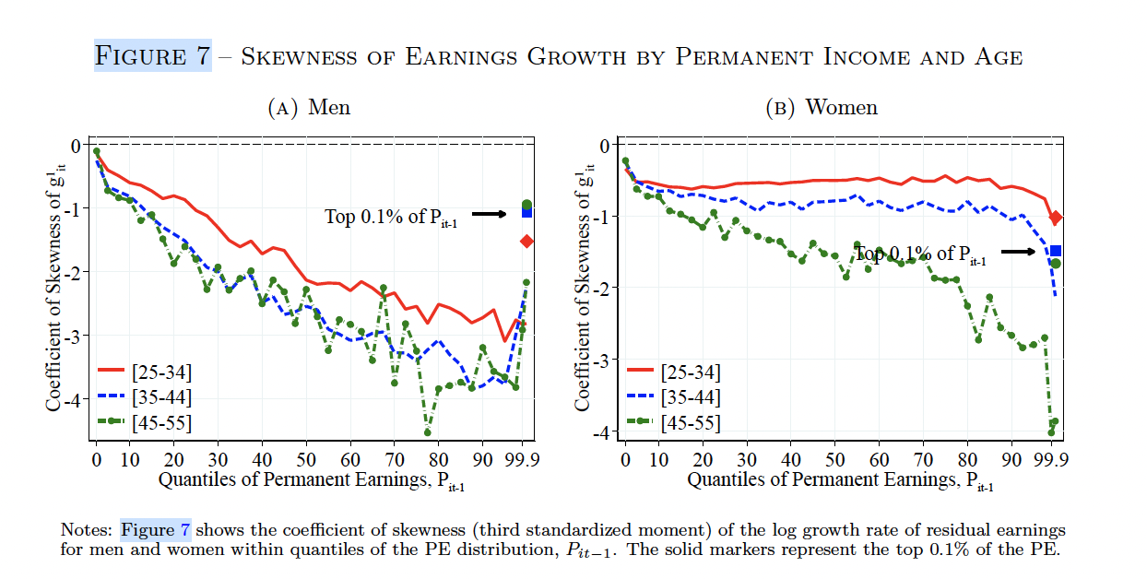
1yr growth of residualised earnings by permanent income

Slide 13
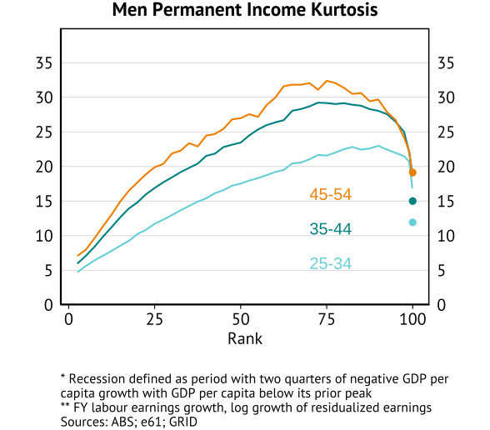
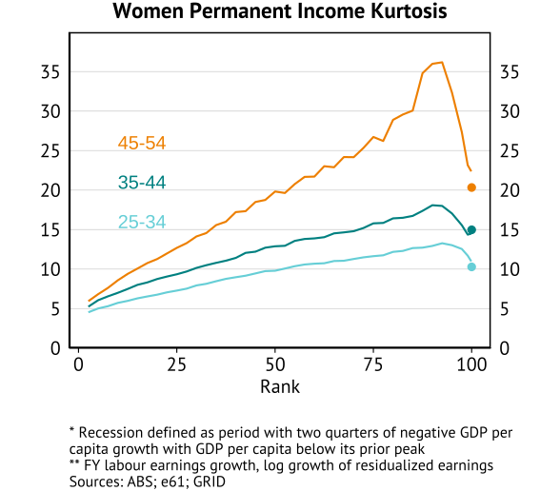
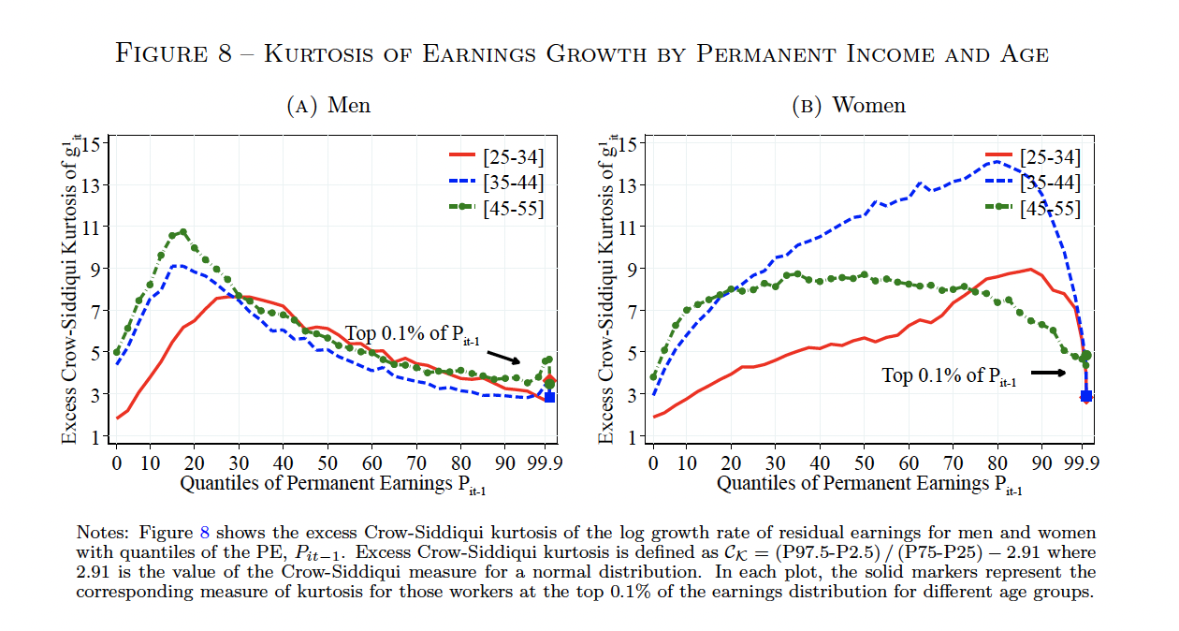
1yr growth of residualised earnings by permanent income

Slide 14
Mobility

Slide 15
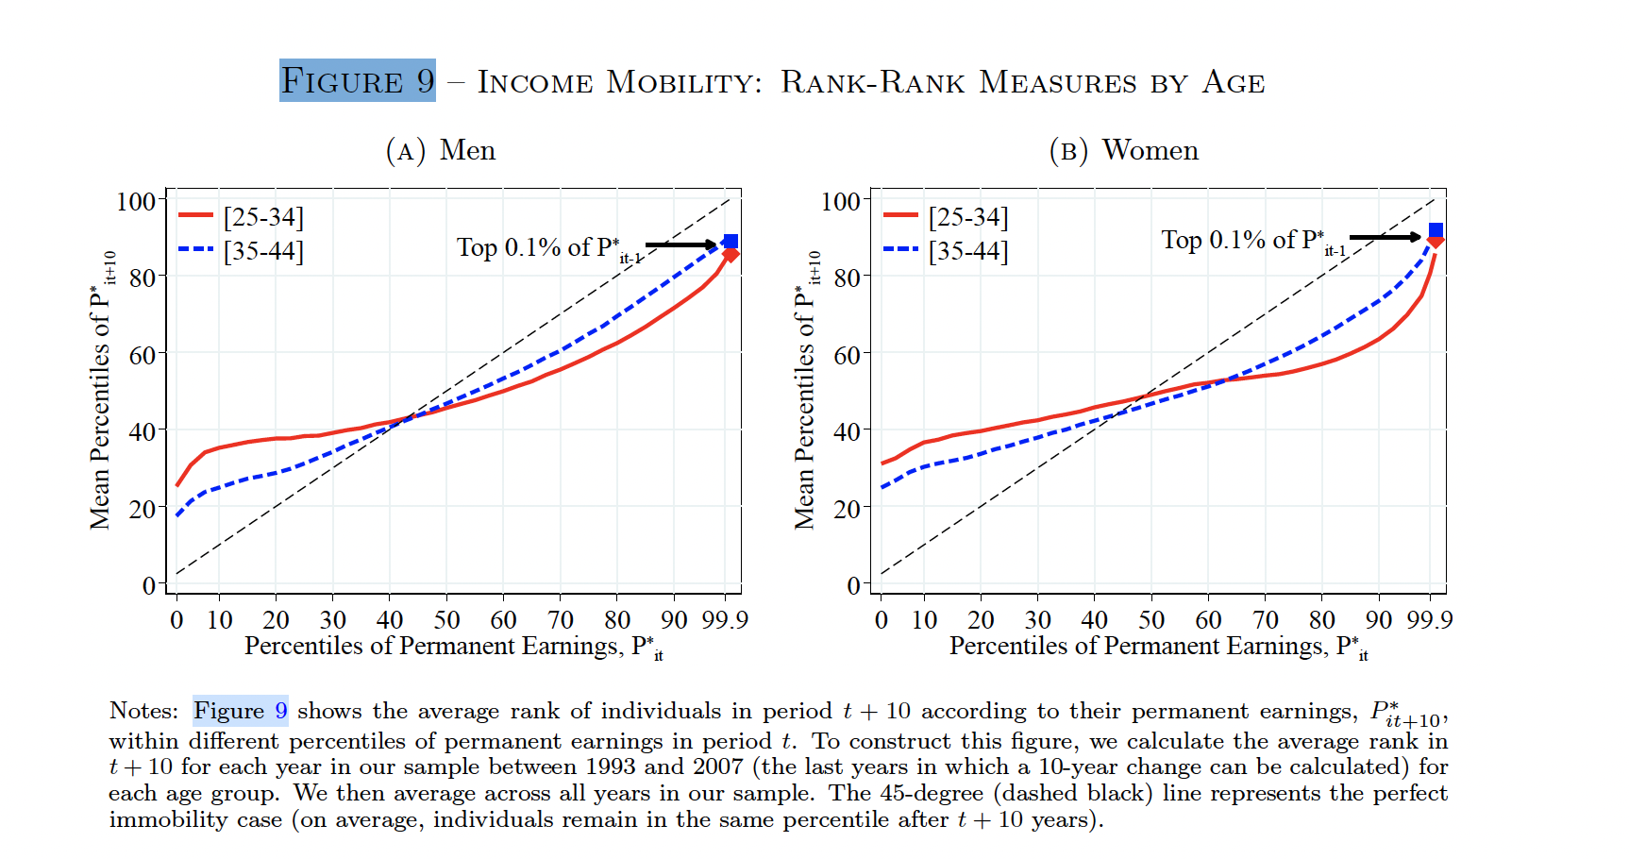
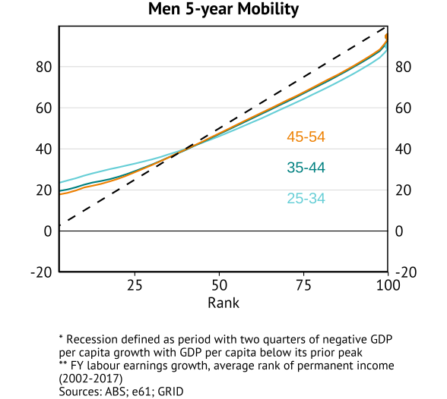
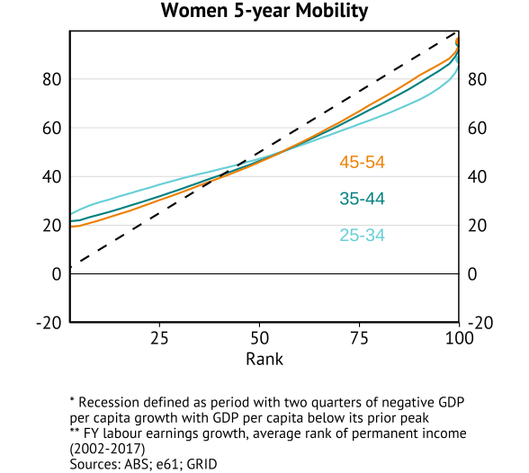
Rank-rank mobility within permanent income distribution

Slide 16
Appendix

Slide 17
Data construction
Start with Gianni’s LEED file
Collapse wage income across all firms in each financial year
If PAYG value is missing, use value from Individual Tax Return
Merge in demographics file
Sample in focus:
Individuals aged between 25 and 55
Individuals with meaningful attachment to the labour force who earn above a cutoff: working full time for at least one quarter of year at the national minimum wage

Slide 18
Insert table 1 from grid paper for whats available in the AUS data

